Slide 1



Department of Information Engineering
Master’s Degree in Computer Engineering
Development of a web app
Stefano Alberton, Marco Alecci, Francisca Chidubem Ezeobi,
Luca Martinelli, Elia Ziroldo
ACADEMIC YEAR 2020/2021

Slide 2


What is HyperU?
Share your ideas and find new peoples that have the right skills to become your new coworkers of your dream’s project!
Follow topics of your interest to have a customized feed!
Create new teams for your ideas and use the chat to interact!

Slide 3
Back-End Structure
REST Api Servlet
REST resources
DAOs
REST Api with response sent in JSON
RestApiServlet that forwards the request to the proper REST resource
Access to database using DAOs
Part of the URIs are filtered through different filters

Slide 4
Example of REST Api: mapping CRUD operations
POST: api/idea
GET: api/idea/{ideaID}
DELETE: api/idea/{ideaID}
PUT: api/idea/{ideaID}
Post a new idea
Get an idea with skills, topics and teams related to it
Update an idea
Delete an idea

Slide 5
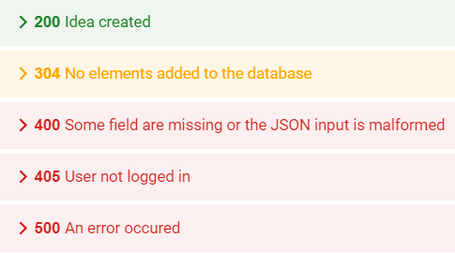
Example of Server – Client communication
Operation
Success Response
POST: api/idea
{
"message": {
"message": "Idea created."
},
"data": ideaID
}
All Responses:
Error 400 Response
{
"message": {
"message": "Title is missing.",
"isError": true,
"errorCode": -600
}
}

Slide 6
Front-End style
Designed with Bootstrap
Icons taken from Feather
Usage of Ajax and JSON
Style with cards and two sidebars
Header bar to access different functions

Slide 7
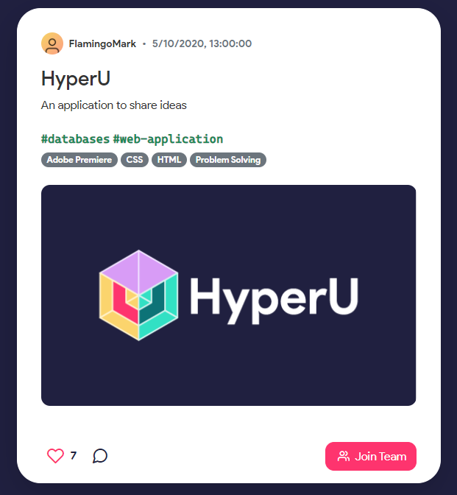
Homepage
Customized feed based on topics followed by the user
Like, comment or send a request to join the team

Slide 8
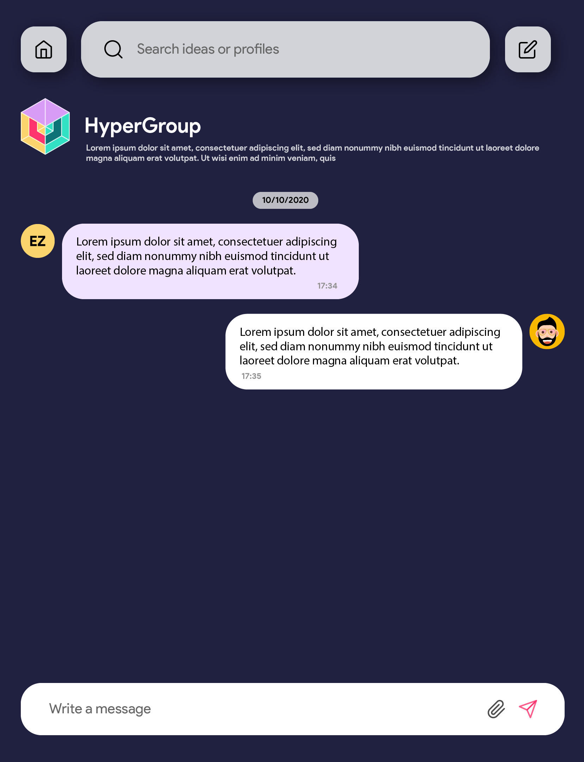
Team Chat Page
Team chat customized with name, description and team image
Send simple text or files

Slide 9
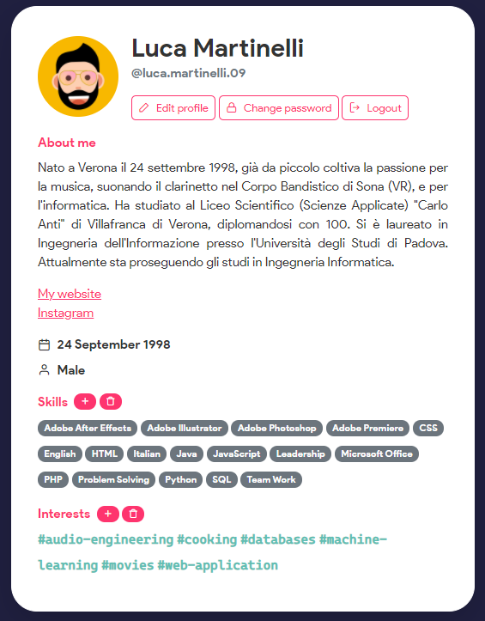
Profile Page
Card with all the personal information of a user
Edit profile buttons displayed only in the profile page of the logged user

Slide 10
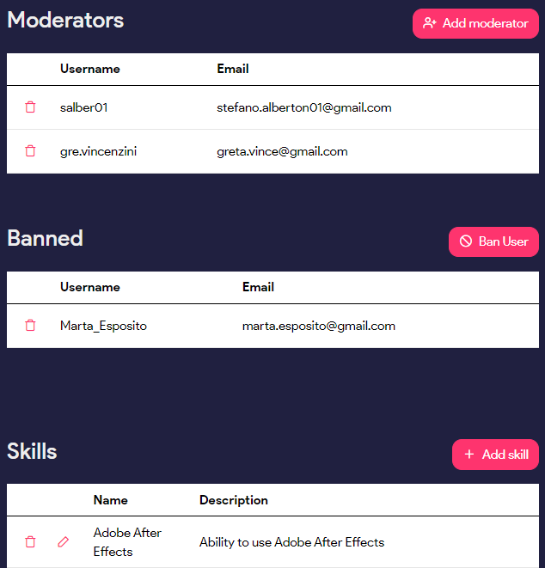
Moderator & Admin Page
List and manage banned users
All Moderators
List and manage all available skills
All Moderators
List and manage all available topics
Only
Admins
List and manage moderators
All Moderators

Slide 11
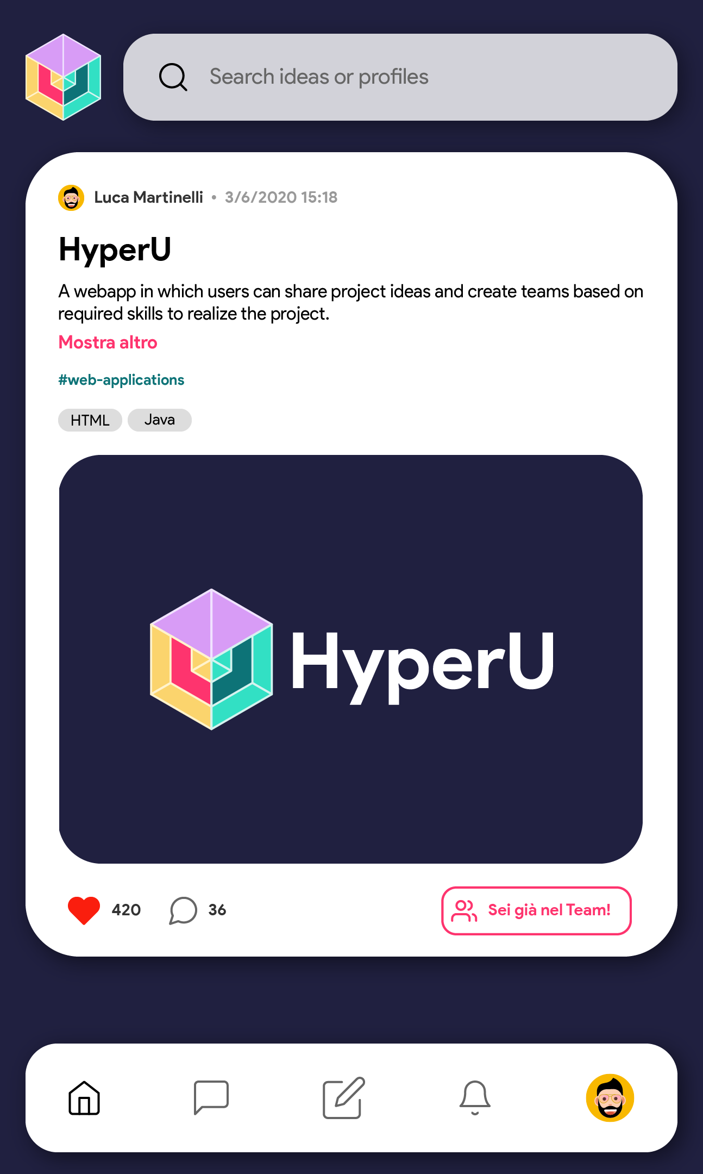
Mobile version
Resize for smaller screen
Access to teams and request from buttons instead of sidebars
Can be installed as Progressive Web App

Slide 12
THANK YOU FOR THE ATTENTION

